Slide 1

Algoritma Pemrograman Dasar 1
Day 2

Slide 2

Profil Mentor
Nama : Fiqri Pratama
Pendidikan Terakhir : S1 Teknik Informatika (2024)
Riwayat Pelatihan / Bootcamp :
1. BBPLK Bekasi (IT Software: 2019)
2. Digitalent Scholarship (Junior Web Developer: 2019)
3. Enigmacamp IT Bootcamp (Fullstack Developer: 2020)
Riwayat Pekerjaan :
1. Fullstack Developer (Bank BTPN)
2 . Mentor Fullstack Web Developer dibimbing Batch 1 - 9

Slide 3
1
Algorithmn
Outline Class
2
JavaScript Introduction
3
Effective Googling for Developers

Slide 4
Algorithm
What is Algorithm?
The word Algorithm is taken from the name of the Muslim scientist Abu Ja'far Muhammad bin Musa Al-Kharizmi (780-846 AD).
Definition
The sequence of steps to solve problems logically and systematically
Big Indonesian Dictionary: Algorithm is a logical sequence of decision making for problem solving.
Algorithms are needed to instruct the computer to take certain steps in solving problems.
Types of writing algorithms :
Description
Flowchart
Pseudocode

Slide 5
Description & Pseudocode
Description
Is an algorithm written in everyday human language. all sentences are written in a systematic, clear, limited and sequential manner
Pseudocode
Informal way of programming description that does not require any strict programming language syntax or underlying technology considerations.

Slide 6
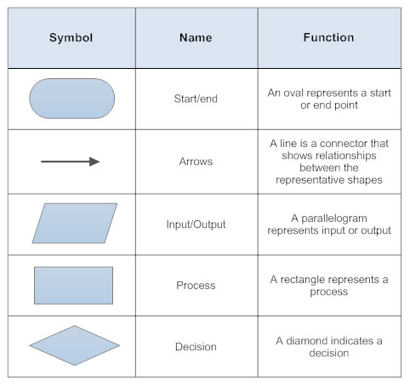
Flowchart
What is Flowchart?
A flowchart is a diagram that depicts a process, system or computer algorithm.

Slide 7
Example : Write an algorithm to choose the largest number from 3 numbers

Slide 8
Description
1. input num1, num2, num3
2. Declare max is 0
3. If num1 is greater than equals num2 and num1 is greater than equals num3, set the max is num 1
4. Otherwise If num2 is greater than equals num1 and num2 is greater than equals num2, set the max is num2
5. Otherwise set the max is num3
6. Print max

Slide 9
Pseudocode
input num1, num2, num3
declare max <- 0
if (num1 >= num2 && num1 >= num3) then
max <- num1
else if (num2 >= num1 && num2 >= num3) then
max <- num2
else
max <- num 3
print max

Slide 10
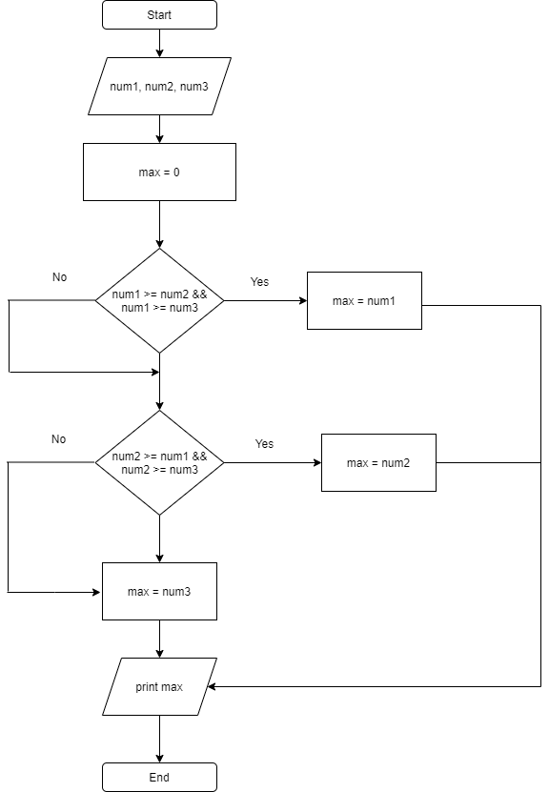
Flowchart

Slide 11
Introduction to JavaScript
What is JavaScript?
Is a programming language that conforms to the ECMAScript specification.
JavaScript is high-level, often just-in-time compiled, and multi-paradigm.
It has curly-bracket syntax, dynamic typing, prototype-based object-orientation, and first-class functions.
JavaScript was initially created to “make web pages alive”.
The programs in this language are called scripts. They can be written right in a web page’s HTML and run automatically as the page loads.
Scripts are provided and executed as plain text. They don’t need special preparation or compilation to run.

Slide 12

Node Js
Node.js is an open-source and cross-platform JavaScript runtime environment. It is a popular tool for almost any kind of project!
Node.js runs the V8 JavaScript engine, the core of Google Chrome, outside of the browser. This allows Node.js to be very performant.

Slide 13


Download and Install NodeJS to run your Javascript in command line
Test your node successfully installed with this command:
Create your Javascript file and save with .js exstension
Run your Javascript Application in your command line

Slide 14
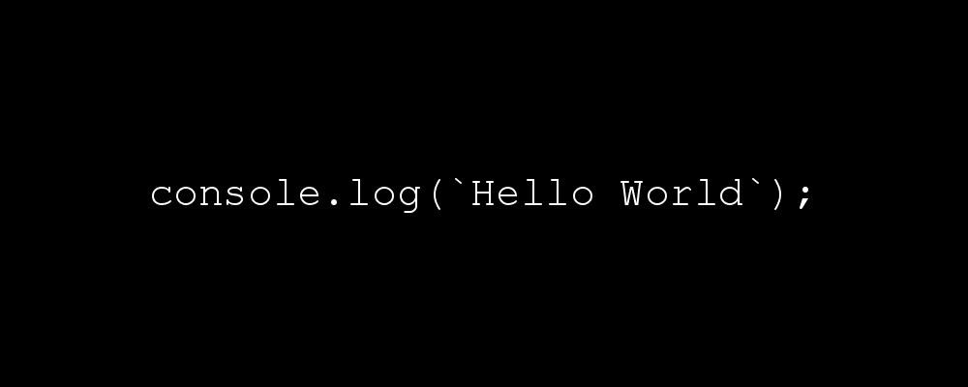
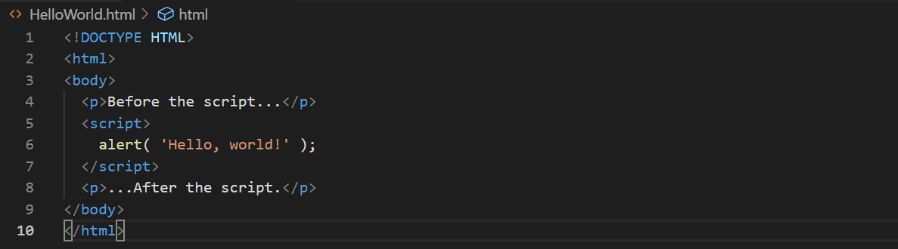
Hello World
Create File hello-world.js and type this words
JavaScript programs can be inserted into any part of an HTML
document with the help of the <script> tag.

Slide 15
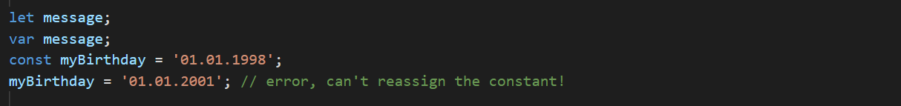
Variable
A variable is a name that represents a value. Variables can be filled with various values such as strings (text), numbers (numbers), objects, arrays, and so on.
We can say that a variable is like a container to store something.
let – is a modern variable declaration.
var – is an old-school variable declaration. Normally we don’t use it at all, but we’ll cover subtle differences from let in the chapter The old "var", just in case you need them.
const – is like let, but the value of the variable can’t be changed.

Slide 16
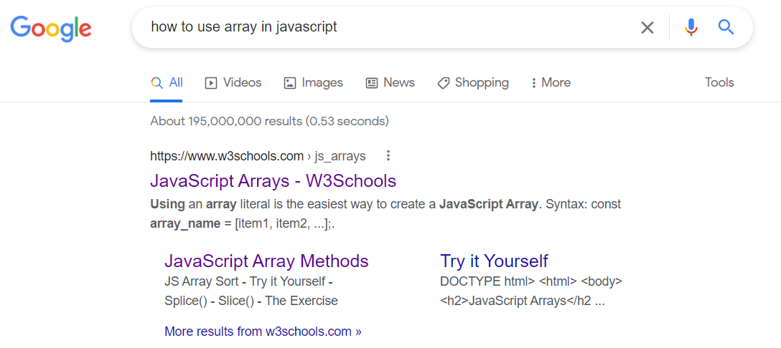
Effective Googling for Developers
As software developers, of course, we often use Google as a means of learning and looking for various information about programming.
This is an effective way to find the information.
Write “How to <subject information>”
Ex.

Slide 17
Thank you

